Slide 1
PROJECT ON DATA STRUCTURES AND ALGORITHMS

Slide 2
Project Name:
Demonstration Of Huffman Encoding
Team members:
Prashant Bhandari (076BCT049)
Pratik Dahal(076BCT051)
Rahul Jha (076BCT053)
Programming Language Used:
Python

Slide 3
HUFFMAN ENCODING
This elegant encoding technique was given by David Albert Huffman (1925–1999), an American pioneer in computer science, in 1952.
It is a lossless data compression algorithm which is carried out by assigning binary codes to input characters based on their frequency.
It can be used to compress data like texts, images, videos etc. without losing any of the details.
The overall goal is to encode the input message using least binary bits.
Encoding is done in such a way that the codes (bit sequences) assigned to one character is not the prefix of code assigned to any other character.

Slide 4
ENCODING ALGORITHM
At first, construct a frequency table consisting of all the unique characters in the text along with their frequency(no of times they are repeated in the text). For example, if the text to be encoded is “bee keeper keeps bees.”, then the frequency table for this text is given as.
characters | Frequency
. | 1
p | 2
r | 1
e | 9
space | 3
b | 2
k | 2
s | 2
characters | Frequency
. | 1
p | 2
r | 1
e | 9
space | 3
b | 2
k | 2
s | 2

Slide 5
Encoding Algorithm (continued)
Arrange the table in ascending order such that characters with least frequency is at the top(beginning).
characters | Frequency
. | 1
r | 1
p | 2
b | 2
k | 2
s | 2
space | 3
e | 9

Slide 6
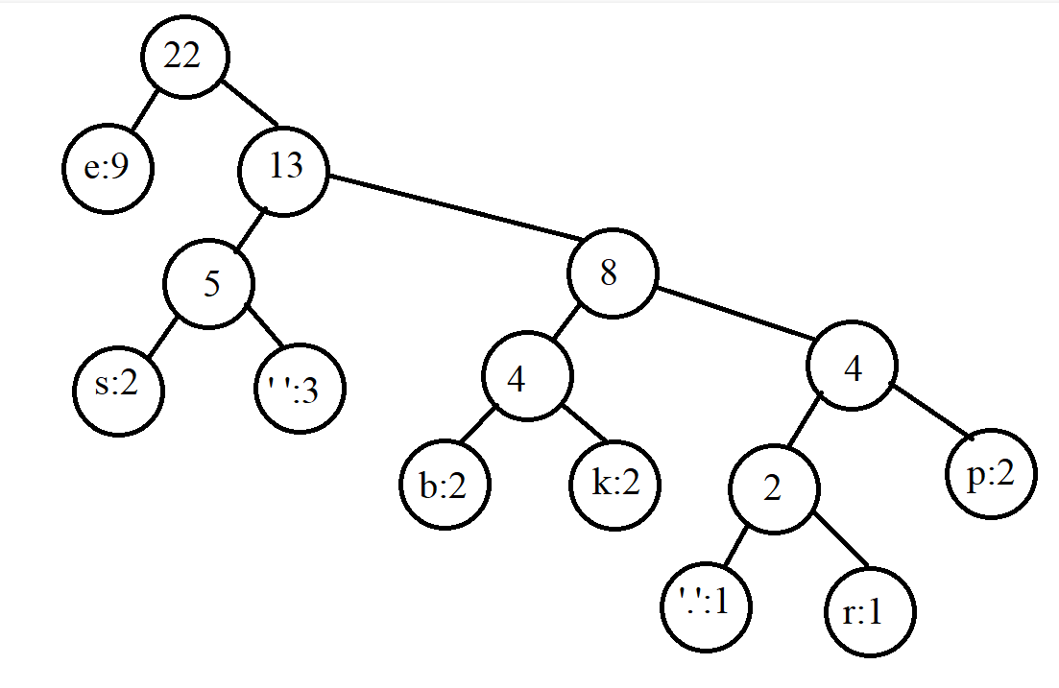
Encoding Algorithm (continued)
Take two characters of least frequencies and construct a node consisting of two leaf nodes. Store the sum of frequencies of the leaf nodes in the parent node after which a tree is obtained as shown below.

Slide 7
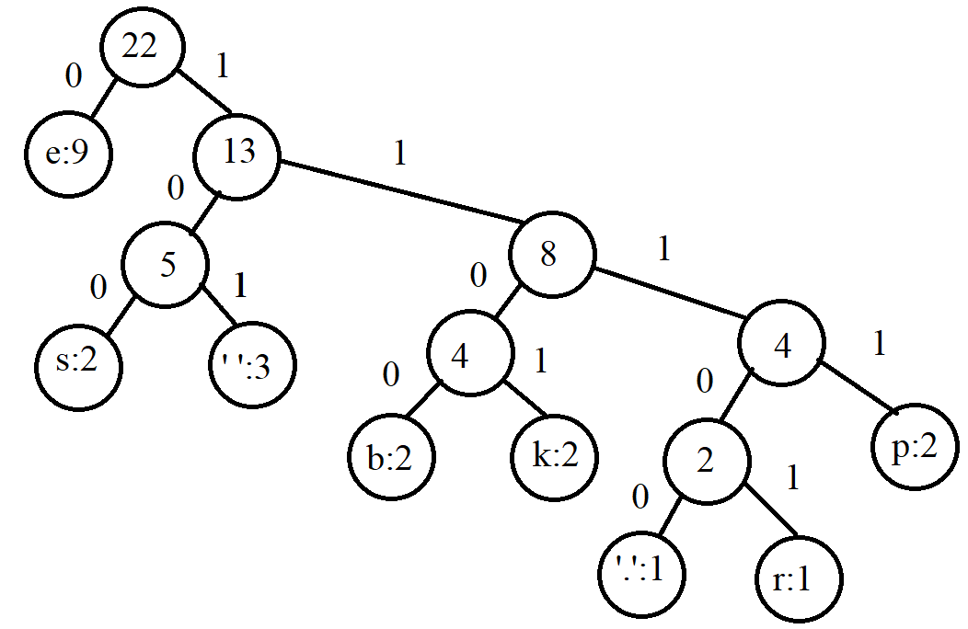
Encoding Algorithm (continued)
Starting from the root node, assign 0 to all the nodes on the left and 1 to the ones on the right. On doing so, the following tree is obtained.

Slide 8
Encoding Algorithm (continued)
Obtain a table for each alphabet in the text along with its encoded string.
Alphabet | Encoded string
e | 0
s | 100
space | 101
b | 1100
k | 1101
p | 1111
r | 11101
. | 11100

Slide 9
Encoding Algorithm (continued)
Using the above frequency table, the original string ‘bee keeper keeps bees.’ can be encoded to the string 1100001011101001111011101101110100111110010111000010011100 which consists of 58 bits.
If the above text was to be encoded in ASCII format, it would consume 22 x 7 = 154 bits. Hence using Huffman Encoding Algorithm, we were able to reduce the size of encoded string by significant amount.

Slide 10
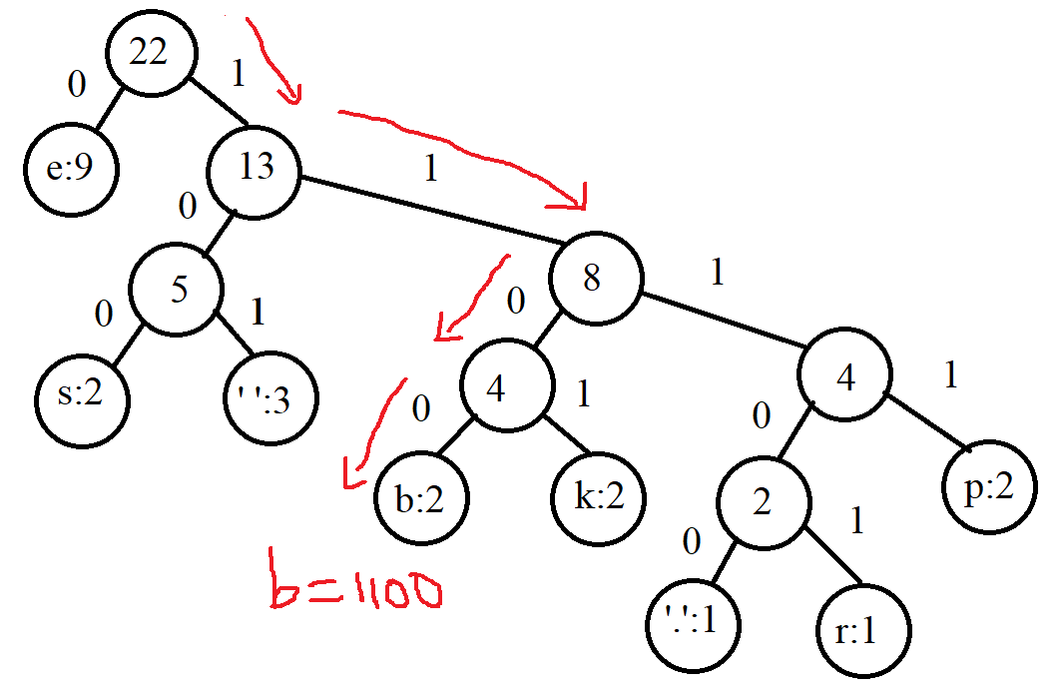
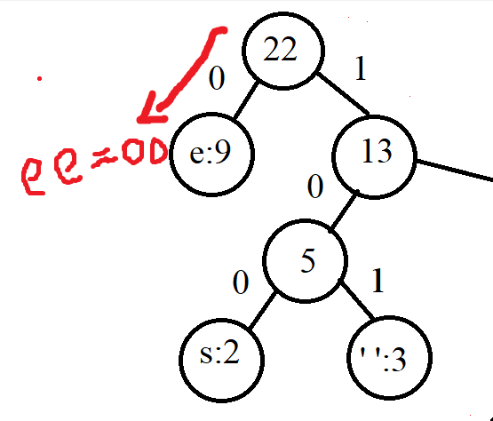
Decoding of encoded string
To decode a binary string, we start from the root node and move left if the encoded string is 0 and right if it is 1. For example, if the encoded string is 110000, starting from the root node we traverse down the tree until a leaf node is encountered. Hence the given string is decoded as ‘bee’.

Slide 11
Applications/advantages of Huffman Encoding
Cryptography
Compression algorithms like JPEG, MP3.
Optimum transfer of data using less bandwidth.
Lossless compression of files.

Slide 12
The End Thank You

